Slide 1

Capstone Project
Angelo Anthony
November 2020

Slide 2
Executive Summary
This dataset represents the client base of an insurance company.
The data has been gathered across a number of years, primarily through profiling, credit scoring and transactional methods.
The problem statement was to identify / profile clients most liable to default on their premiums such that the company can do a better job of identifying these policy holders early on and follow up to ensure premiums are paid.
In terms of the models to be run, it is generally preferred to run multiple models and compare output to select the best fit. We have used three overarching criteria to pick these models:
Given that we are looking to understand the relationship between a set of independent variables and a particular output, in this case the dependent variable, we will focus on Supervised learning models.
Within this category, narrowing down to models that work best for classification problems and finally,
Using ensemble models to enhance accuracy
Based on the foregoing, a total of 6 models were used with the best results being generated by the Logistic Regression model. In summary, a client profile that is at higher risk of defaulting on premiums would be those with a history of delays in previous premium payments, have a high level of cash pay and were sourced via Channels C & D.

Slide 3
The Data Set
This is an excel file with 79,853 observations and 17 variables.
The data represents details on policyholders that have either renewed or defaulted on their premiums.
There seem to be no Missing Values in the dataset.
The ID variable seems to be a serial number and hence can be ignored for analysis perspective.
The Age variable is given in days which is somewhat unusual. Ideally, this should be shown in years for easy understanding. The data is quite widespread with policyholder ages ranging from 21 years to 103 years.
Income again is very widespread ranging from 24,030 to 90,262,600. So certain to be outliers which will need to be treated if significant.
Vehicles owned ranges from 1 - 3. So presumably this data relates to Vehicle Insurance as it would be quite a co-incidence not to have any policy holders without a vehicle otherwise.
Number of dependents ranges from 1 - 4. Noteworthy that there are no policy holders with zero dependents.
The data seems to be of a subset of customers with high risk score, as the range for this data set is between 91.9 and 99.89.
There seems to be a variety of client acquisition channels, but the specifcs of these channels is not provided.
Premium renewed – 0 means the client has defaulted on the Premium payment and 1 means that he has not. That is our TARGET or DEPENDANT variable.
This is a heavily skewed data base as only circa 6% of clients have defaulted on their premiums. This needs to be kept in mind as we move forward with model building.

Slide 4
Data PRE-PROCESSING
The ID column is not relevant for this exercise and has been removed.
The Age column has been converted to years instead of days.
The Categorical variables have been changed to Factors.
Perc_premium_paid_by_cash_credit has been renamed Perc_cash_pay.
The dependent variable has been renamed from Renewal to Default.
Outliers were treated on the basis of Inter Quartile Range. The variables treated are as follows:
Age – Capped at Max IQR 93.5 years. There were 44 outliers beyond this point so not a significant sample.
Income - Capped at Max IQR of 468,210. There were 26 outliers beyond this point so not a significant sample. Additionally, for ease of visualization, the Income variable has been divided by 1000 to provide an X axis in thousands.
Risk Score – Capped at Min IQR of 97.8. Given that only circa 5% of the data set is outside the Min IQR the cap is deemed reasonable and not expected to materially affect the underlying assumptions of the dataset.
# of Premiums Paid – Capped at Max IQR of 24.5. Given that less than 3% of the data set is outside the Max IQR the cap is deemed reasonable and not expected to materially affect the underlying assumptions of the dataset.
Premium – Capped at Max IQR of 26,400. Given that less than 6% of the data set is outside the Max IQR the cap is deemed reasonable and not expected to materially affect the underlying assumptions of the dataset.

Slide 5
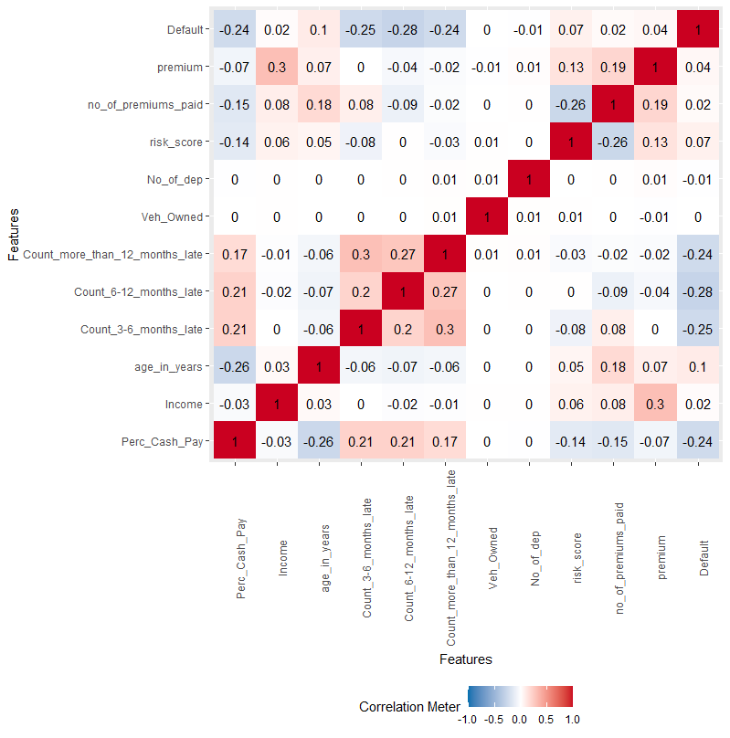
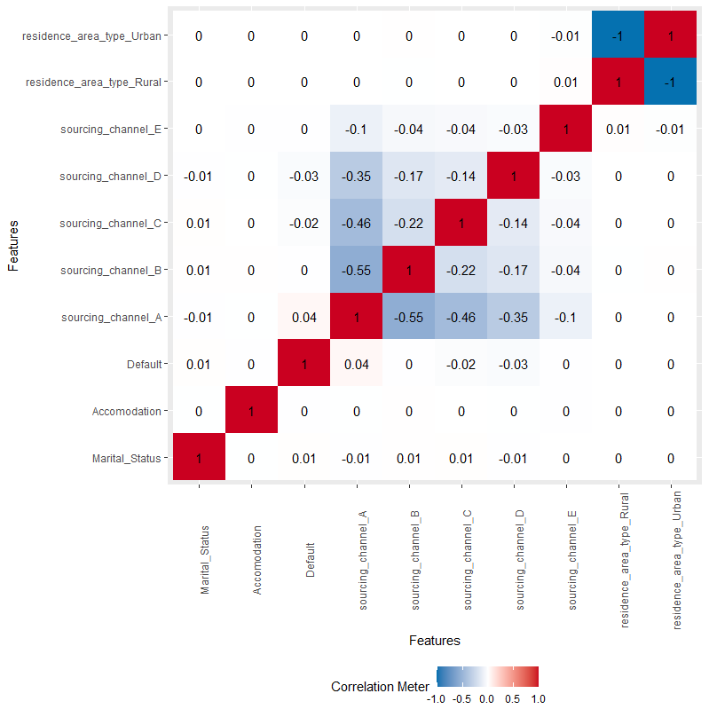
Exploratory data analysis
Two Correlation Plots were run, with one based on all numerical variables along with the Dependent variable and another with all Factor variables along with the Dependent variable. Both plots reveal minimal correlation amongst the variables or with the Dependent variable. The plots are appended below.
A Chi squared test for significance also noted only sourcing channel as significant with p < 0.05.

Slide 6
Exploratory data analysis – contd.
There is a discernable relationship between the percentage of premiums that policy holders pay in cash and delays. In effect, higher the percentage of cash pay, higher the propensity for delays in premium payments across all time buckets.
Income peaks between 40 – 60 years, which corresponds with premium amounts. Conversely though, risk score seems to reduce in this age bucket which is contradictory and needs to be explored.
There seems to be a discernable correlation between Income and Premium Amounts and No. of Premiums paid. Additionally, Risk Score also improves as Income increases. The following graphs illustrate these points:
There is some correlation seen in past dues across buckets, especially upto mid- point. There is also a definite increase in no. of premiums paid with higher instances of repeat offenses. This is to be expected as you need to have been paying premiums for longer to have multiple instances of premiums being overdue for > 12 months.
The no. of premiums paid by the policy holders seems to have a positive correlation with Premium amounts, as shown in the graph below:
Channel A is the most used to acquire policy holders representing 54% of the data set. Channel A seems characterized by the older set of clients, with the lowest Income and lowest Premiums of all Channels. This also tallies with the fact that the older clients pay less of their premiums in Cash.
Conversely, Channels C, D & E represent a younger clientele with higher Incomes, Premiums and higher cash pay.

Slide 7
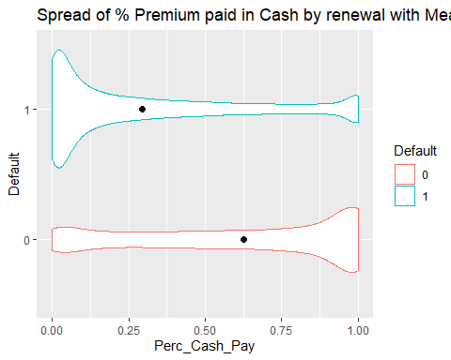
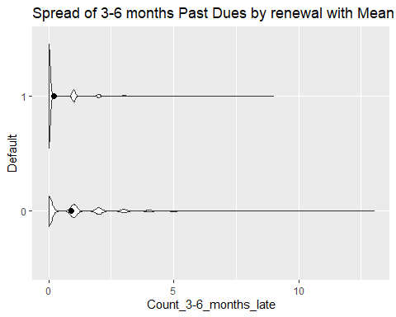
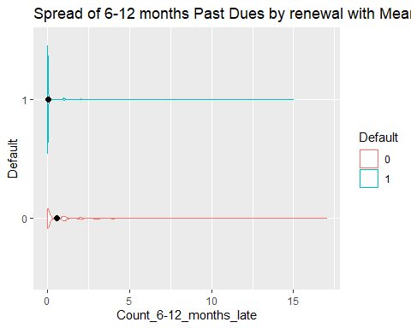
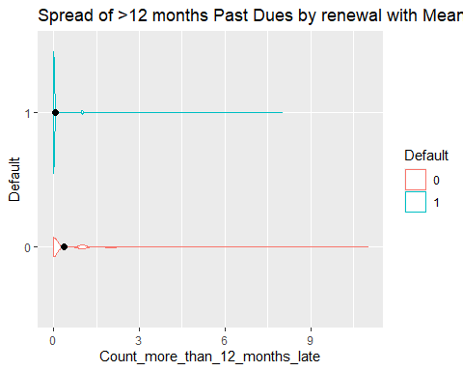
Exploratory data analysis – dependent variable
Clear differentiation between Defaulters and Non- Defaulters in Percentage Cash Pay and No. of delayed premiums in all three buckets. This is followed by slightly less strong differentiations in Income, Age & Premium Amount. The critical differences are shown in graphical form, and all are tabulated as follows:
% CASH PAY
3-6 MONTHS DELAY
6-12 MONTHS DELAY
> 12 MONTHS DELAY

Slide 8
Modelling process
Post the adjustments made during EDA, the following actions were undertaken to prepare the data set for modelling:
Dummy variables were created for all Character variables (i.e. Marital Status, Accommodation, Sourcing Channels and Residence Type) as well as the Dependent Variable. Post this, the columns representing the original variables were deleted.
Scaling was then undertaken on all Numerical variables.
The data set was then split between Training and Test sets on the ratio 75:25. We have worked on the full data set and not a sub- set.
This is a highly skewed dataset in that the Dependent variable has only 6% of defaulters. As such, in order to ensure a more balanced data set, SMOTE (Synthetic Minority Oversampling Technique) was run on the Training data set. This resulted in the default metric increasing from 6% of the data set to around 18%.
As the Dependent variable is set up as NO (non- defaulters) and YES (defaulters), and as the purpose of the exercise is to identify defaulters, models will be measured based on Specificity as opposed to Sensitivity. In this manner, the efficiency of the models will be based on how well each is able to identify potential defaulters.

Slide 9
Outcome of model building process
A total of 6 models were built and run. The suitability of the models were evaluated based on the ability to identify the highest number of defaulters, so high Specificity, along with an acceptable level of accuracy. The results are tabulated below.
Based on the outcome, the Logistic Regression model is taken as the best fit.

Slide 10
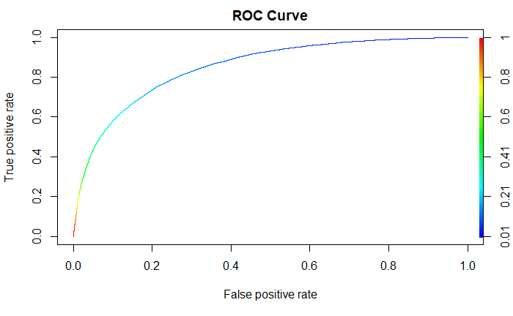
Logistic regression model – modelling process
The Logistic Regression model can be fine tuned based on where the probability cut off is set. In the first instance, the ROC curve was used to identify a possible cut off that maximizes the TPR whilst minimizing the FPR. The ROC curve is provided.
Based on the curve, a value of between 0.2 – 0.4 was determined to be the best. However, this in turn had to be evaluated as a tradeoff between False Positive and True Negative. This is tabulated below.
There are obvious time, resourcing and cost implications depending on which cut off is used. Given that the objective is to identify as many potential defaulters as possible, a cut off of 0.2 provides the best outcome but comes with the cost of tracing almost 3,200 non-defaulters as well. Conversely, a cut off at 0.4 would provide the least number of false leads to follow through but risks missing a higher number of potential defaulters.
On balance, assuming that the cost of even one defaulter would far outweigh the cost of tracking a portion of non-defaulters, we recommend the cut off of 0.2.
 | Cut off – 0.2 | Cut off – 0.3 | Cut off – 0.4
Accuracy | 0.82 | 0.89 | 0.92
False Positive (count) | 3,202 | 1,581 | 898
True Negative (count) | 839 | 673 | 531

Slide 11
Logistic regression model – output explained
The variables that predict default, in order of importance are as follows:
newColName <chr> | Overall <dbl>
1 | Perc_Cash_Pay | 48.083532
5 | Count_6_12_months_late | 36.125038
4 | Count_3_6_months_late | 34.079671
6 | Count_more_than_12_months_late | 25.831082
3 | age_in_years | 16.546244
2 | Income | 11.652104
9 | no_of_premiums_paid | 10.426332
8 | risk_score | 10.408180
10 | sourcing_channelA1 | 9.352329
12 | sourcing_channelD1 | 6.427556
14 | residence_area_typeUrban1 | 4.377893
11 | sourcing_channelC1 | 4.020041
13 | residence_area_typeRural1 | 3.359655
7 | No_of_dep | 2.322163

Slide 12
Logistic regression model – output explained
Based on this order of importance and the following output of the model itself, we can define how each variable affects potential default:
For example, holding all other variables unchanged:
For every unit increase in Percentage Cash Pay, the odds of default increase by 1.82.
Similarly, for every additional late payment in the 6 – 12 months bucket, the odds of default increases by 1.56.
For every additional late payment in the 3 – 6 months bucket, the odds of default increases by 1.41.
For every additional late payment in the greater than 12-month bucket, the odds of default increases by 1.31.
Conversely, for clients sourced via Channel A, the odds of default decrease by 1.31 compared to the other channels.

Slide 13
Final recommendation
The output of the Logistic Regression model should ideally be further parsed for these three or four critical criteria in deciding which clients the follow up unit should focus on. As an initial test, we would recommend that the model output is distilled based on the following:
Where Percentage Cash Pay is higher than the Median of 16.7%
Delayed payments across all 3 buckets
Delayed payments greater than 2 in any bucket in increasing order of importance.
Sourced via Channel D followed by Channel C.
This may make the quantum of follow ups manageable in the context of cost and returns as well. Over time, the process can be further refined as either some of the follow ups are automated or the staff become more familiar with the overall process such as to be able to handle a higher volume of follow ups.
It will also be important to set up a governance framework around the end-to-end process. As the feedback from the initial test phase comes in, it may be possible to further tweak the final list for follow up based on experiences of the front-line staff.
It should also be noted that given the quality of the output, there is a high chance that at least some of the clients called are not in danger of defaulting. Given this scenario, it will be important to ensure that the initial follow ups are designed not to alienate the client base but to start a dialogue that can be further refined using the other variables in the model.

